Slide 1


Java SWING (GUI) And Event Driven Programming

Slide 2
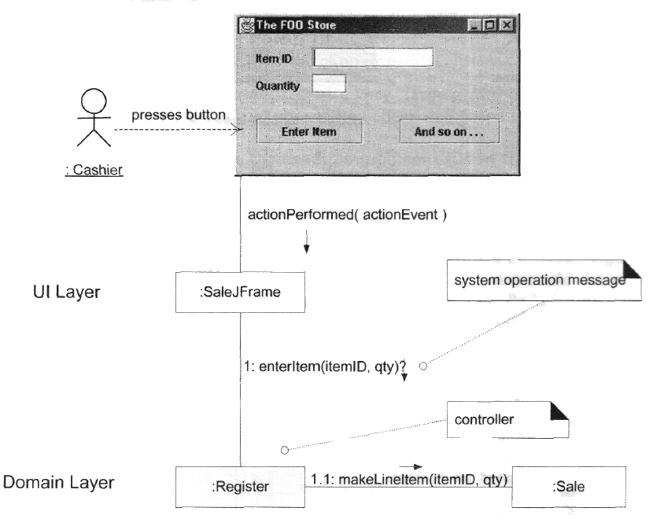
Problem: What first object in the business logic layer should receive the message from the UI layer?

Slide 3
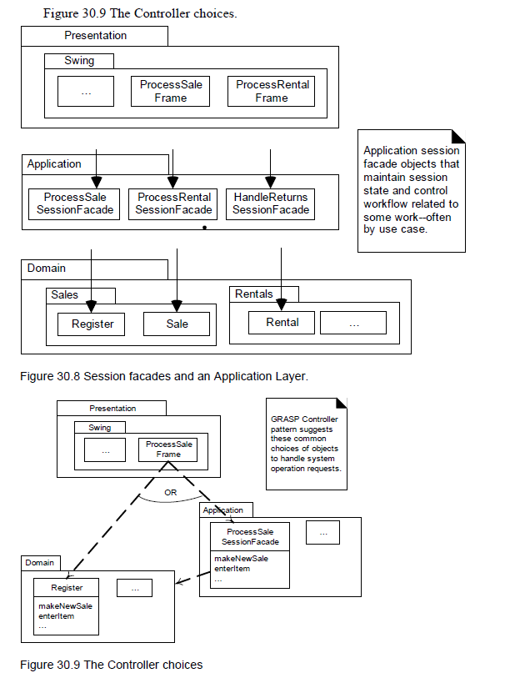

Slide 4
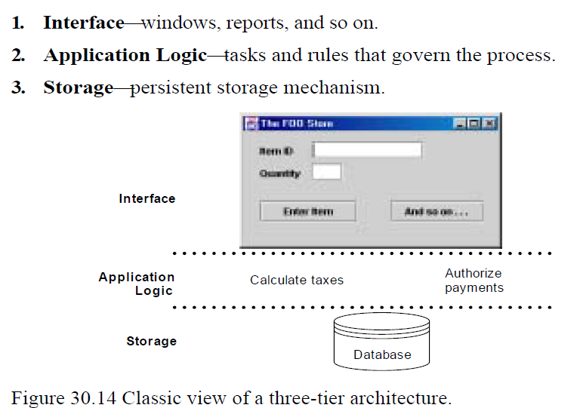

Slide 5
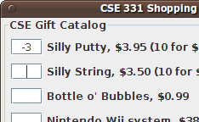
Why learn GUIs?
Learn about event-driven programming techniques
Practice learning and using a large, complex API
A chance to see how it is designed and learn from it:
model-view separation
design patterns
refactoring vs. reimplementing an ailing API
Because GUIs are neat!
Caution: There is way more here than you can memorize.
Part of learning a large API is "letting go."
You won't memorize it all; you will look things up as you need them.
But you can learn the fundamental concepts and general ideas.

Slide 6

Java GUI History
Abstract Windowing Toolkit (AWT): Sun's initial effort to create a set of cross-platform GUI classes. (JDK 1.0 - 1.1)
Maps general Java code to each operating system's real GUI system.
Problems: Limited to lowest common denominator; clunky to use.
Swing: A newer GUI library written from the ground up that allows much more powerful graphics and GUI construction. (JDK 1.2+)
Paints GUI controls itself pixel-by-pixel rather than handing off to OS.
Benefits: Features; compatibility; OO design.
Problem: Both exist in Java now; easy to get them mixed up; still have to use both in various places.

Slide 7
AWT to Swing
AWT: Abstract Windowing Toolkit
import java.awt.*
Swing: new with Java
import javax.swing.*
Extends AWT
New improved components
Standard dialog boxes, tooltips, …
Look-and-feel, skins
Event listeners

Slide 8
Portability
The java.awt library contains heavyweight classes
Implemented via the Java Virtual Machine
Dependent on target platform
The javax.swing library contains lightweight classes
Implemented in Java
Independent of target platform

Slide 9

GUI terminology
window: A first-class citizen of the graphical desktop.
Also called a top-level container.
examples: frame, dialog box, applet
component: A GUI widget that resides in a window.
Also called controls in many other languages.
examples: button, text box, label
container: A logical grouping for storing components.
examples: panel, box

Slide 10
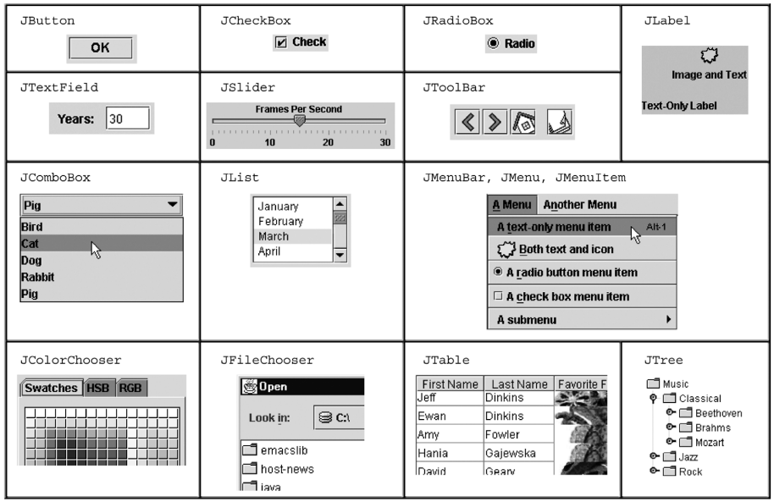
Components

Slide 11
Swing inheritance hierarchy
Component (AWT)
Window
Frame
JFrame (Swing)
JDialog
Container
JComponent (Swing)
JButton JColorChooser JFileChooser
JComboBox JLabel JList
JMenuBar JOptionPane JPanel
JPopupMenu JProgressBar JScrollbar
JScrollPane JSlider JSpinner
JSplitPane JTabbedPane JTable
JToolbar JTree JTextArea
JTextField ...
import java.awt.*;
import javax.swing.*;

Slide 12
Component properties
Each has a get (or is) accessor and a set modifier method.
examples: getColor, setFont, setEnabled, isVisible
name | type | description
background | Color | background color behind component
border | Border | border line around component
enabled | boolean | whether it can be interacted with
focusable | boolean | whether key text can be typed on it
font | Font | font used for text in component
foreground | Color | foreground color of component
height, width | int | component's current size in pixels
visible | boolean | whether component can be seen
tooltip text | String | text shown when hovering mouse
size, minimum / maximum / preferred size | Dimension | various sizes, size limits, or desired sizes that the component may take

Slide 13
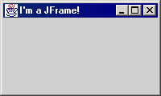
JFrame
a graphical window to hold other components
public JFrame() public JFrame(String title) Creates a frame with an optional title.
Call setVisible(true) to make a frame appear on the screen after creating it.
public void add(Component comp) Places the given component or container inside the frame.

Slide 14
More JFrame
public void setDefaultCloseOperation(int op) Makes the frame perform the given action when it closes.
Common value passed: JFrame.EXIT_ON_CLOSE
If not set, the program will never exit even if the frame is closed.
public void setSize(int width, int height) Gives the frame a fixed size in pixels.
public void pack() Resizes the frame to fit the components inside it snugly.

Slide 15
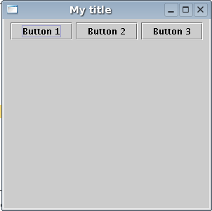
JButton
a clickable region for causing actions to occur
public JButton(String text) Creates a new button with the given string as its text.
public String getText() Returns the text showing on the button.
public void setText(String text) Sets button's text to be the given string.

Slide 16
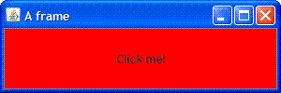
GUI example
import java.awt.*; // Where is the other button?
import javax.swing.*;
public class GuiExample1 {
public static void main(String[] args) {
JFrame frame = new JFrame();
frame.setDefaultCloseOperation(JFrame.EXIT_ON_CLOSE);
frame.setSize(new Dimension(300, 100));
frame.setTitle("A frame");
JButton button1 = new JButton();
button1.setText("I'm a button.");
button1.setBackground(Color.BLUE);
frame.add(button1);
JButton button2 = new JButton();
button2.setText("Click me!");
button2.setBackground(Color.RED);
frame.add(button2);
frame.setVisible(true);
}
}

Slide 17
Sizing and positioning
How does the programmer specify where each component appears, how big each component should be, and what the component should do if the window is resized / moved / maximized / etc.?
Absolute positioning (C++, C#, others): Programmer specifies exact pixel coordinates of every component.
"Put this button at (x=15, y=75) and make it 70x31 px in size."
Layout managers (Java): Objects that decide where to position each component based on some general rules or criteria.
"Put these four buttons into a 2x2 grid and put these text boxes in a horizontal flow in the south part of the frame."

Slide 18
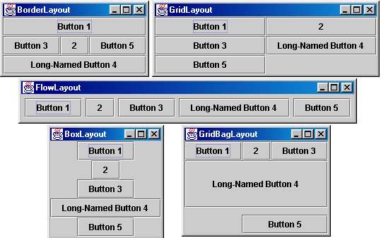
Containers and layout
Place components in a container; add the container to a frame.
container: An object that stores components and governs their positions, sizes, and resizing behavior.

Slide 19
JFrame as container
A JFrame is a container. Containers have these methods:
public void add(Component comp) public void add(Component comp, Object info) Adds a component to the container, possibly giving extra information about where to place it.
public void remove(Component comp)
public void setLayout(LayoutManager mgr) Uses the given layout manager to position components.
public void validate() Refreshes the layout (if it changes after the container is onscreen).

Slide 20

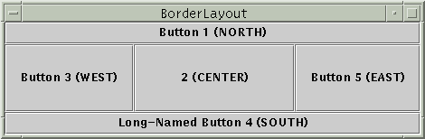
Preferred sizes
Swing component objects each have a certain size they would "like" to be: Just large enough to fit their contents (text, icons, etc.).
This is called the preferred size of the component.
Some types of layout managers (e.g. FlowLayout) choose to size the components inside them to the preferred size.
Others (e.g. BorderLayout, GridLayout) disregard the preferred size and use some other scheme to size the components.
Buttons at preferred size: Not preferred size:

Slide 21
FlowLayout
public FlowLayout()
treats container as a left-to-right, top-to-bottom "paragraph".
Components are given preferred size, horizontally and vertically.
Components are positioned in the order added.
If too long, components wrap around to the next line.
myFrame.setLayout(new FlowLayout());
myFrame.add(new JButton("Button 1"));
The default layout for containers other than JFrame (seen later).

Slide 22
BorderLayout
public BorderLayout()
Divides container into five regions:
NORTH and SOUTH regions expand to fill region horizontally, and use the component's preferred size vertically.
WEST and EAST regions expand to fill region vertically, and use the component's preferred size horizontally.
CENTER uses all space not occupied by others.
myFrame.setLayout(new BorderLayout());
myFrame.add(new JButton("Button 1"), BorderLayout.NORTH);
This is the default layout for a JFrame.

Slide 23
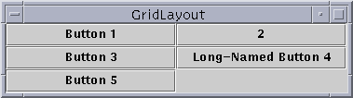
GridLayout
public GridLayout(int rows, int columns)
Treats container as a grid of equally-sized rows and columns.
Components are given equal horizontal / vertical size, disregarding preferred size.
Can specify 0 rows or columns to indicate expansion in that direction as needed.

Slide 24
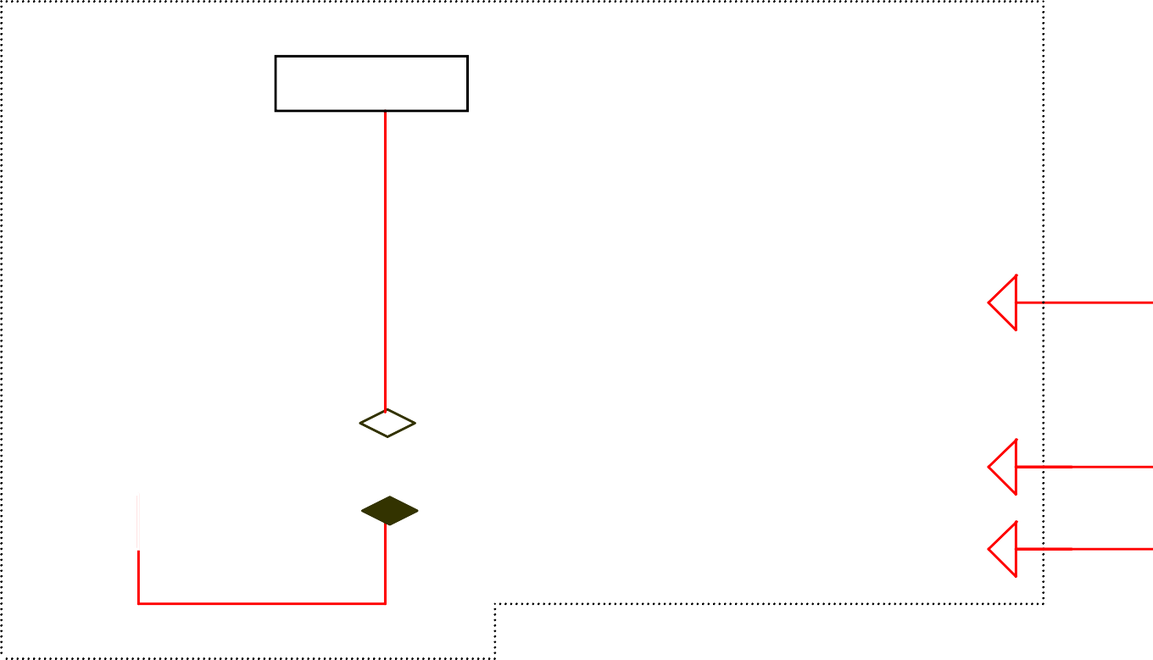
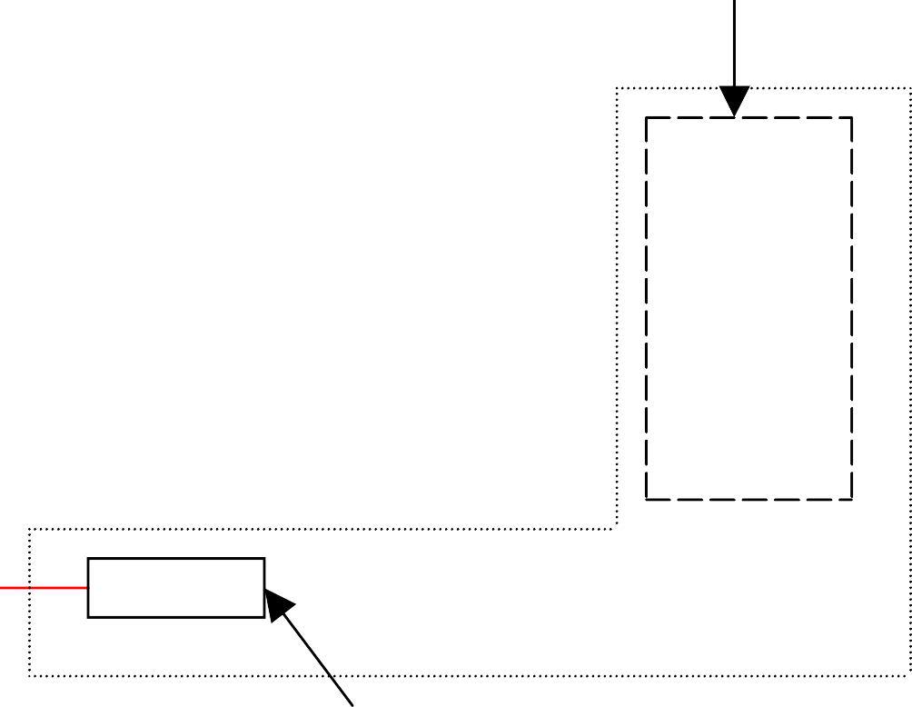
GUI Class Hierarchy
Dimension
Classes in the java.awt package
LayoutManager
1
Heavyweight
Font
FontMetrics
Object
Color
Panel
Applet
JApplet
Graphics
Component
Container
Window
Frame
JFrame
*
Dialog
JDialog
JComponent
Swing Components
in the javax.swing package
Lightweight

Slide 25
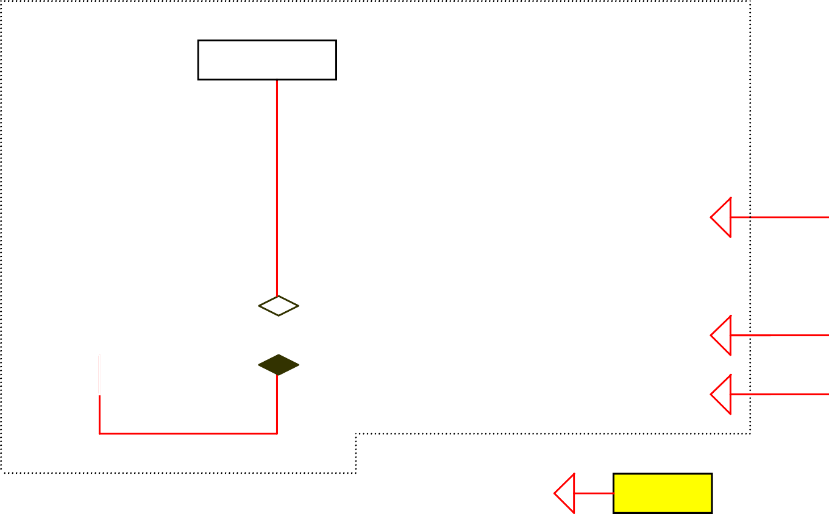
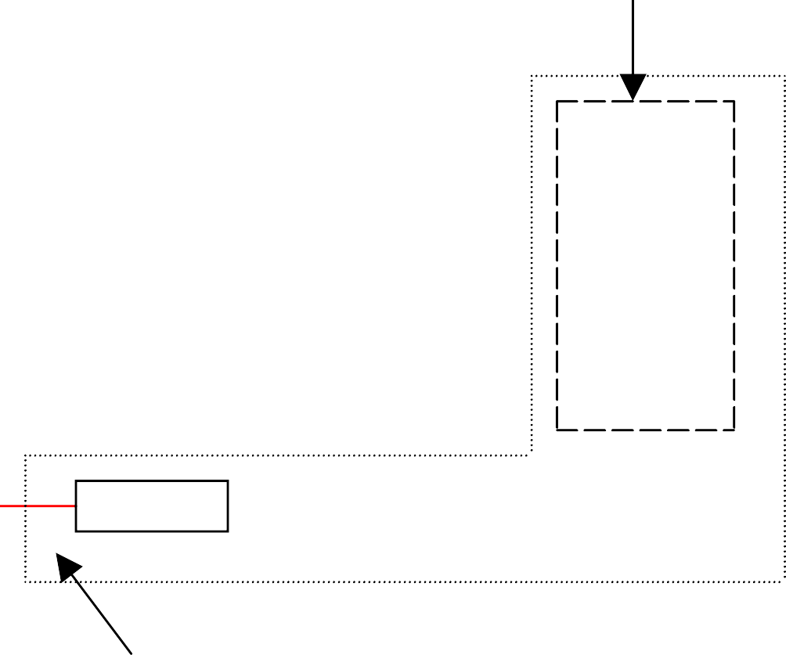
Container Classes
Dimension
Classes in the java.awt package
LayoutManager
1
Heavyweight
Font
FontMetrics
Object
Color
Panel
Applet
JApplet
Graphics
Component
Container
Window
Frame
JFrame
*
Dialog
JDialog
JComponent
JPanel
Swing Components
in the javax.swing package
Lightweight

Slide 26
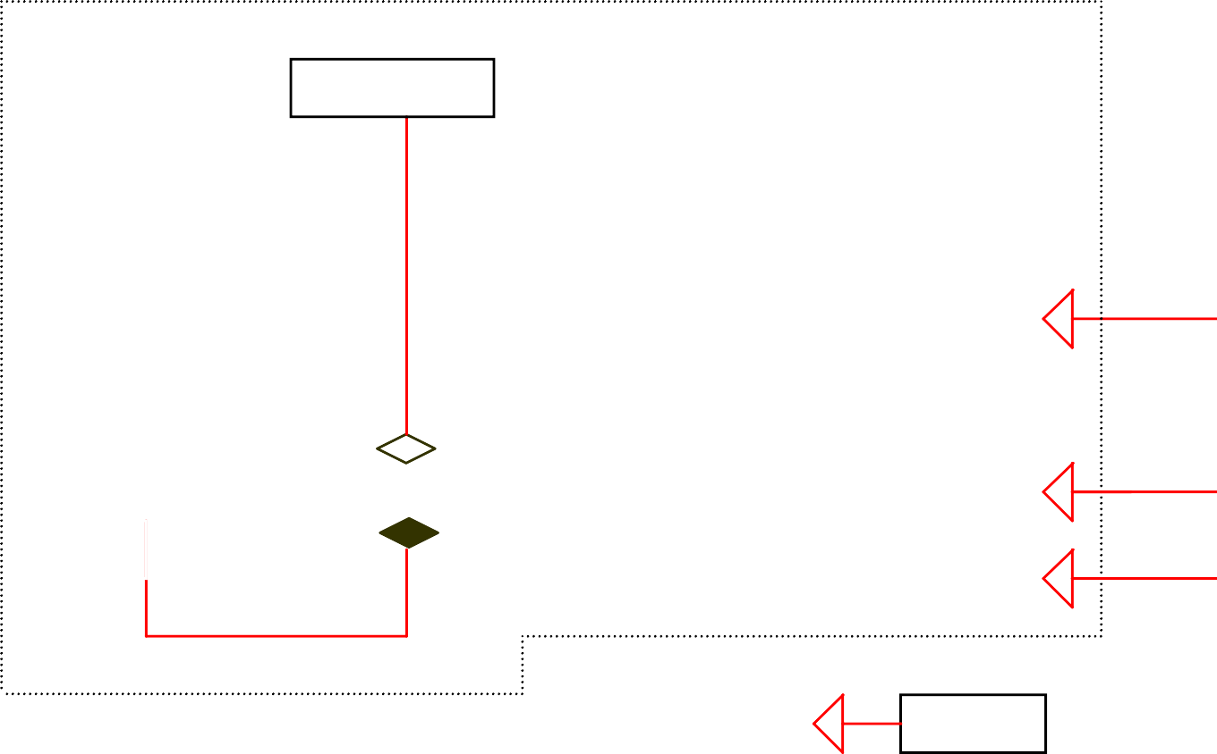

GUI Helper Classes
Dimension
Classes in the java.awt package
LayoutManager
1
Heavyweight
Font
FontMetrics
Object
Color
Panel
Applet
JApplet
Graphics
Component
Container
Window
Frame
JFrame
*
Dialog
JDialog
JComponent
JPanel
Swing Components
in the javax.swing package
Lightweight

Slide 27
Swing Components
JCheckBoxMenuItem
JMenuItem
JMenu
AbstractButton
JButton
JRadioButtonMenuItem
JToggleButton
JCheckBox
JComponent
JEditorPane
JRadioButton
JTextComponent
JTextField
JPasswordField
JTextArea
JLabel
JList
JComboBox
JPanel
JOptionPane
JScrollBar
JSlider
JTabbedPane
JSplitPane
JLayeredPane
JSeparator
JScrollPane
JRootPane
JToolBar
JMenuBar
JPopupMenu
JFileChooser
JColorChooser
JToolTip
JTree
JTable
JTableHeader
JInternalFrame
JProgressBar
JSpinner

Slide 28
Core Swing Components
JCheckBoxMenuItem
JMenuItem
JMenu
AbstractButton
JButton
JRadioButtonMenuItem
JToggleButton
JCheckBox
JComponent
JEditorPane
JRadioButton
JTextComponent
JTextField
JPasswordField
JTextArea
JLabel
JList
JComboBox
JPanel
JOptionPane
JScrollBar
JSlider
JTabbedPane
JSplitPane
JLayeredPane
JSeparator
JScrollPane
JRootPane
JToolBar
JMenuBar
JPopupMenu
JFileChooser
JColorChooser
JToolTip
JTree
JTable
JTableHeader
JInternalFrame
JProgressBar
JSpinner

Slide 29
AWT Classes
AWTEvent
Container
Panel
Applet
Font
Button
Window
Frame
FontMetrics
Label
Dialog
FileDialog
 |  | TextField
 |  | TextArea
Object
Color
TextComponent
Graphics
List
Component
Choice
CheckBox
LayoutManager
CheckBoxGroup
Canvas
MenuComponent
MenuItem
Menu
MenuBar
Scrollbar
10

Slide 30
Frames
A frame is a window not contained inside another window
javax.swing.JFrame
+JFrame()
+JFrame(title: String)
+getSize(width: int, height: int): void
+setLocation(x: int, y: int): void
+setVisible(visible: boolean): void
+setDefaultCloseOperation(mode: int): void
+setLocationRelativeTo (c: Component): void
Creates a default frame with no title. Creates a frame with the specified title. Specifies the size of the frame.
Specifies the upper-left corner location of the frame. Sets true to display the frame.
Specifies the operation when the frame is closed.
Sets the location of the frame relative to the specified component.
If the component is null, the frame is centered on the screen.

Slide 31
Content Frame Delegation
In Java 1.4, required to add GUI elements to content panes:
frame.getContentPane().add(new JButton(“OK”));
In Java 1.5, frame delegates automatically to the content pane:
frame.add(new JButton(“OK”));

Slide 32
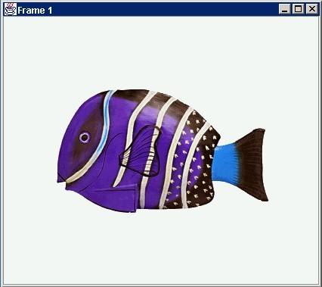
Anatomy of a GUI
GUI
Internal structure
JFrame
JPanel
JFrame
containers
JButton
JPanel
JButton
JLabel
JLabel

Slide 33
Using a GUI Component 2
Create it
Configure it
order
Add children (if container)
Add to parent (if not JFrame)
Listen to it
important

Slide 34
Build from bottom up
Create:
Frame
Panel
Components
Listeners
Add: (bottom up)
listeners into components
components into panel
panel into frame
Listener
JLabel
JButton
JPanel
JFrame

Slide 35
Example
Create it
Instantiate object:
Configure it
b = new JButton(“press me”);
Properties:
Methods:
Add it
b.text = “press me”; b.setText(“press me”);
panel.add(b);
Listen to it
Events: Listeners
JButton

Slide 36
Application Code
import javax.swing.*;
class hello {
public static void main(String[] args){
JFrame f = new JFrame(“title”);
JPanel p = new JPanel();
JButton b = new JButton(“press me”);
p.add(b); // add button to panel f.setContentPane(p); // add panel to frame
•
•
•
}
}
f.show();
press me

Slide 37
Layout Manager
FlowLayout
null
GridLayout
none, programmer sets x,y,w,h
Left to right, Top to bottom
BorderLayout n
CardLayout
GridBagLayout
w
e
JButton
c
One at a time
s

Slide 38
Example
// Fig. 11.9: TextFieldFrame.java
// Demonstrating the JTextField class.
import java.awt.FlowLayout;
import java.awt.event.ActionListener;
import java.awt.event.ActionEvent;
import javax.swing.JFrame;
import javax.swing.JTextField;
import javax.swing.JPasswordField;
import javax.swing.JOptionPane;
10
public class TextFieldFrame extends JFrame
{
13
14
15
16
17
18
19
20
21
22
23
24
25
26
27
private JTextField textField1; // text field with set size private JTextField textField2; // text field constructed with text private JTextField textField3; // text field with text and size private JPasswordField passwordField; // password field with text
// TextFieldFrame constructor adds JTextFields to JFrame public TextFieldFrame()
{
super( "Testing JTextField and JPasswordField" ); setLayout( new FlowLayout() ); // set fra
Create a new JTextField
me layout
// construct textfield with 10 columns
textField1 = new JTextField( 10 );
add( textField1 ); // add textField1 to JFrame

Slide 39
28
29
30
31
32
33
34
35
36
37
38
39
40
41
42
43
44
45
46
47
48
49
50
51
52
53
54
55
56
// construct textfield with default text
textField2 = new JTextField( "Enter text here" );
add( textField2 ); // add textField2 to JFrame
Create a new JTextField
// construct textfield with default text and 21 columns
textField3 = new JTextField( "Uneditable text field", 21 );
textField3.setEditable( false ); // disable editing
add( textField3 ); // add textField3 to JFrame
Make this JTextField uneditable
// construct passwordfield with default text
passwordField = new JPasswordField( "Hidden text" );
add( passwordField ); // add passwordField to JFrame
Create a new JPasswordField
// register event handlers
TextFieldHandler handler = new TextFieldHandler();
textField1.addActionListener( handler );
textField2.addActionListener( handler );
textField3.addActionListener( handler );
passwordField.addActionListener( handler );
Create event handler
} // end TextFieldFrame constructor
Register event handler
// private inner class for event handling
private class TextFieldHandler implements ActionListener
Create event handler class by
{
implementing the
// process text field events
ActionListener interface
public void actionPerformed( ActionEvent event )
{
String string = ""; // declare string to display
Declare actionPerformed
method

Slide 40
57
58
59
60
61
62
63
64
65
66
67
68
69
70
71
72
73
74
75
76
77
78
79
80
// user pressed Enter in JTextField textField1
if ( event.getSource() == textField1 )
Test if the source of the event is the
string = String.format( "textField1: %s",
first text field
event.getActionCommand()
);
Get text from text field
// user pressed Enter in JTextField textField2
else if ( event.getSource() == textField2 )
Test if the source of the event is the
string = String.format( "textField2: %s",
second text field
event.getActionCommand()
);
Get text from text field
// user pressed Enter in JTextField textField3
else if ( event.getSource() == textField3 )
Test if the source of the event is the
string = String.format( "textField3: %s",
third text field
event.getActionCommand()
);
Get text from text field
// user pressed Enter in JTextField passwordField
else if ( event.getSource() == passwordField )
Test if the source of the event is the
string = String.format( "passwordField: %s",
password field
new String( passwordField.getPassword() ) );
// display JTextField content JOptionPane.showMessageDialog( null, string );
} // end method actionPerformed
} // end private inner class TextFieldHandler
Get password from password field
81 } // end class TextFieldFrame

Slide 41
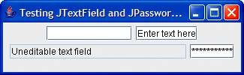
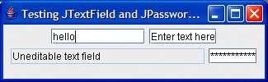
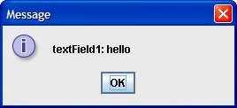
// Fig. 11.10: TextFieldTest.java
// Testing TextFieldFrame.
import javax.swing.JFrame;
4
public class TextFieldTest
{
public static void main( String args[] )
{
TextFieldFrame textFieldFrame = new TextFieldFrame();
textFieldFrame.setDefaultCloseOperation( JFrame.EXIT_ON_CLOSE );
textFieldFrame.setSize( 325, 100 ); // set frame size
textFieldFrame.setVisible( true ); // display frame
} // end main
} // end class TextFieldTest

Slide 42
Event Listeners

Slide 43
Events and Listeners
An event can be defined as a type of signal to the program that something has happened.
The event is generated by external user actions such as mouse movements, mouse button clicks, and keystrokes, or by the operating system, such as a timer.
Events are responded to by event listeners.

Slide 44
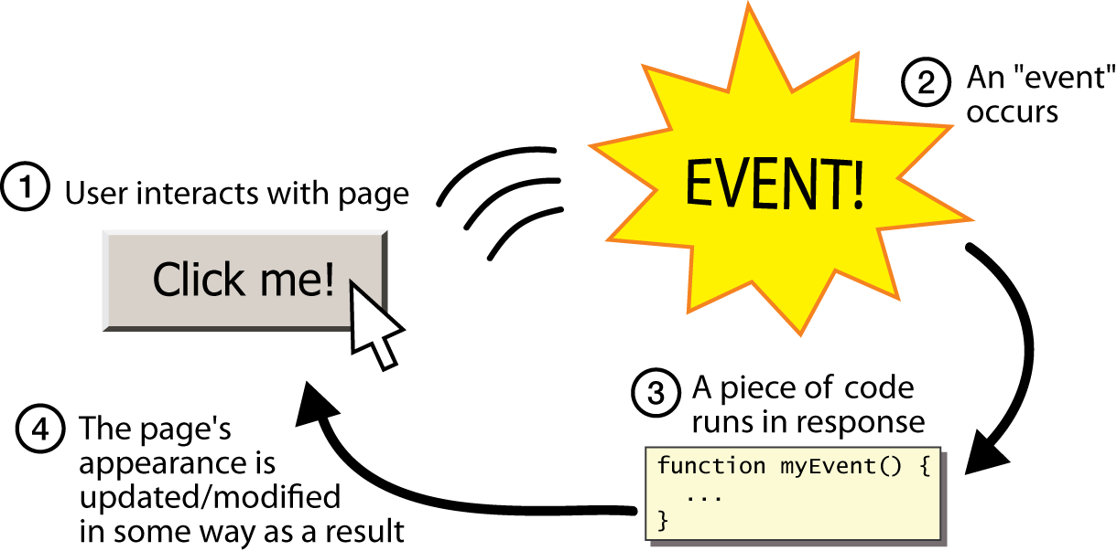
Graphical events
event: An object that represents a user's interaction with a GUI component; can be "handled" to create interactive components.
listener: An object that waits for events and responds to them.
To handle an event, attach a listener to a component.
The listener will be notified when the event occurs (e.g. button click).

Slide 45
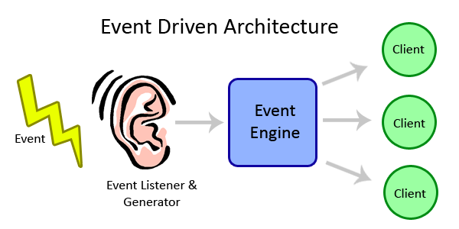
Event-driven programming
event-driven programming: A style of coding where a program's overall flow of execution is dictated by events.
Rather than a central "main" method that drives execution, the program loads and waits for user input events.
As each event occurs, the program runs particular code to respond.
The overall flow of what code is executed is determined by the series of events that occur, not a pre-determined order.

Slide 46
Event hierarchy
EventObject
AWTEvent (AWT)
ActionEvent
TextEvent
ComponentEvent
FocusEvent
WindowEvent
InputEvent
KeyEvent
MouseEvent
EventListener
AWTEventListener
ActionListener
TextListener
ComponentListener
FocusListener
WindowListener
KeyListener
MouseListener
import java.awt.event.*;

Slide 47

Action events
action event: An action that has occurred on a GUI component.
The most common, general event type in Swing. Caused by:
button or menu clicks,
check box checking / unchecking,
pressing Enter in a text field, ...
Represented by a class named ActionEvent
Handled by objects that implement interface ActionListener

Slide 48
Implementing a listener
public class name implements ActionListener {
public void actionPerformed(ActionEvent event) {
code to handle the event;
}
}
JButton and other graphical components have this method:
public void addActionListener(ActionListener al) Attaches the given listener to be notified of clicks and events that occur on this component.

Slide 49

Nested classes
nested class: A class defined inside of another class.
Usefulness:
Nested classes are hidden from other classes (encapsulated).
Nested objects can access/modify the fields of their outer object.
Event listeners are often defined as nested classes inside a GUI.

Slide 50
Nested class syntax
// enclosing outer class
public class name {
...
// nested inner class
private class name {
...
}
}
Only the outer class can see the nested class or make objects of it.
Each nested object is associated with the outer object that created it, so it can access/modify that outer object's methods/fields.
If necessary, can refer to outer object as OuterClassName.this

Slide 51
Static inner classes
// enclosing outer class
public class name {
...
// non-nested static inner class
public static class name {
...
}
}
Static inner classes are not associated with a particular outer object.
They cannot see the fields of the enclosing class.
Usefulness: Clients can refer to and instantiate static inner classes:
Outer.Inner name = new Outer.Inner(params);

Slide 52
GUI event example
public class MyGUI {
private JFrame frame;
private JButton stutter;
private JTextField textfield;
public MyGUI() {
...
stutter.addActionListener(new StutterListener());
}
...
// When button is clicked, doubles the field's text.
private class StutterListener implements ActionListener {
public void actionPerformed(ActionEvent event) {
String text = textfield.getText();
textfield.setText(text + text);
}
}
}

Slide 53
Selected User Actions
User Action | Source Object | Event Type Generated
Click a button | JButton | ActionEvent
Click a check box | JCheckBox | ItemEvent, ActionEvent
Click a radio button | JRadioButton | ItemEvent, ActionEvent
Press return on a text field | JTextField | ActionEvent
Select a new item | JComboBox | ItemEvent, ActionEvent
Select an item from a List | JList | ListSelectionEvent
Window opened, closed, etc. | Window | WindowEvent
Mouse pressed, released, etc. | Any Component | MouseEvent
Key released, pressed, etc. | Any Component | KeyEvent

Slide 54
Java AWT Event
Listener Interfaces
ActionListener
KeyListener
MouseListener
MouseMotionListener
TextListener
WindowListener
ListSelectionListener
AdjustmentListener
ComponentListener
ContainerListener
FocusListener
ItemListener
All are in the java.awt.event or javax.swing.event package All are derived from EventListener in the java.util package
NOTE: any object that will respond to an event must implement a listener interface.

Slide 55
Selected Event Handlers
Event Class | Listener Interface | Listener Methods (Handlers)
ActionEvent | ActionListener | actionPerformed(ActionEvent)
ItemEvent | ItemListener | itemStateChanged(ItemEvent)
ListSelection | ListSelection | valueChanged
Event | Listener | (ListSelectionEvent)

Slide 56
Adapters
Listeners are typically interfaces, therefore requiring all methods be implemented
Use an adapter class to provide convenience implementations of unused methods:
addWindowListener(new WindowAdapter() {
public void windowActivated(WindowEvent event) {
System.out.println("Window activated");
– }
– });

Slide 57
Event-Driven Programming (iii)
Listener classes respond to actions
e.g. override the java.awt.event.actionPerformed() method
Listener classes must be registered with the GUI objects they are listening for:
e.g. via the okButton.addActionListener() method

Slide 58
Mouse Events (i)
java.awt.event.InputEvent
+getWhen(): long
+isAltDown(): boolean
+isControlDown(): boolean
+isMetaDown(): boolean
+isShiftDown(): boolean
Returns the timestamp when this event occurred.
Returns whether or not the Alt modifier is down on this event. Returns whether or not the Control modifier is down on this event.
Returns whether or not the Meta modifier is down on this event Returns whether or not the Shift modifier is down on this event.
java.awt.event.MouseEvent
+getButton(): int
+getClickCount(): int
+getPoint(): java.awt.Point
+getX(): int
+getY(): int
Indicates which mouse button has been clicked.
Returns the number of mouse clicks associated with this event. Returns a Point object containing the x and y coordinates.
Returns the x-coordinate of the mouse point. Returns the y-coordinate of the mouse point.

Slide 59
Mouse Events (ii)
java.awt.event.MouseListener
+mousePressed(e: MouseEvent): void
+mouseReleased(e: MouseEvent): void
+mouseClicked(e: MouseEvent): void
+mouseEntered(e: MouseEvent): void
+mouseExited(e: MouseEvent): void
java.awt.event.MouseMotionListener
+mouseDragged(e: MouseEvent): void
+mouseMoved(e: MouseEvent): void
Invoked when the mouse button has been pressed on the source component.
Invoked when the mouse button has been released on the source component.
Invoked when the mouse button has been clicked (pressed and released) on the source component.
Invoked when the mouse enters the source component. Invoked when the mouse exits the source component.
Invoked when a mouse button is moved with a button pressed.
Invoked when a mouse button is moved without a button pressed.
30

Slide 60
Keyboard Events
Capture keyboard events via the KeyListener interface:
– keyPressed(KeyEvent e _{Home}
)
e)
VK_HOME VK_PGUP
– keyReleased(KeyEvent Page Up
– keyTyped(KeyEvent e)
Page Down
…
Arrow Keys
VK_PGDN
VK_UP
java.awt.event.InputEvent
VK_DOWN VK_RIGHT VK_LEFT
Returns the character associated with the key in this event. Returns the integer keyCode associated with the key in this event.
java.awt.event.KeyEvent
+getKeyChar(): char
+getKeyCode(): int

Slide 61
Timer Events
Use timers (the java.awt.Timer class) to control animations, trigger other events, etc.
javax.swing.Timer
+Timer( delay: int, listener: ActionListener)
+addActionListener(listener: ActionListener): void
+sta rt(): void
+stop( ): void
+setDelay(delay: int): void
Creates a Timer with a specified dela y in milliseconds a nd an ActionListener.
Adds an ActionListener to the timer.
Starts this timer. Stops this timer.
Sets a new de lay value for this timer.

Slide 62
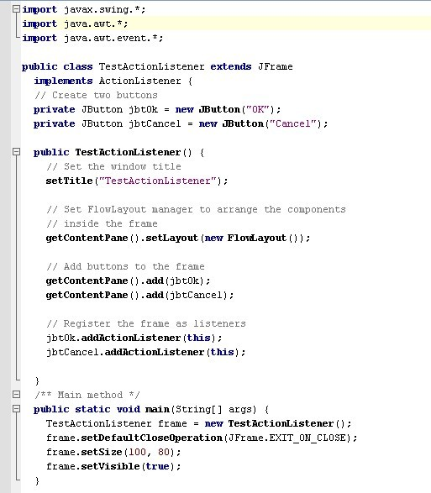
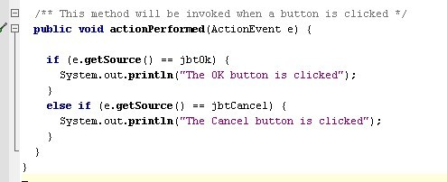
Handling Simple Action Events
The method for responding to an Action event.
Implementing the listener interface
Registering the frame to be a listener for action events generated by the two buttons

Slide 63
Handling Simple Action Events –
a closer look at the event-handling method
actionPerformed is a method required for all ActionListeners
An Event object’s getSource() method returns a reference to the Component object that generated the event.

Slide 64
Alternative Approaches to Listening
Implement the listener with the main application class, and have the one listener assigned to all components generating the events
Advantage: simplicity for beginner programmers
Disadvantage: event-handler method may require if-statement or switch with several branches when multiple components generate the event
Use inner classes to implement the listeners and create a different instance as each component’s listener.
Named inner class or anonymous inner class (This is the approach used in the textbook most of the time)
Advantage: no need to test within the listeners for determining which component sent the event. Each component has its own dedicated listener
Disadvantage: harder to understand for novice programmers

Slide 65
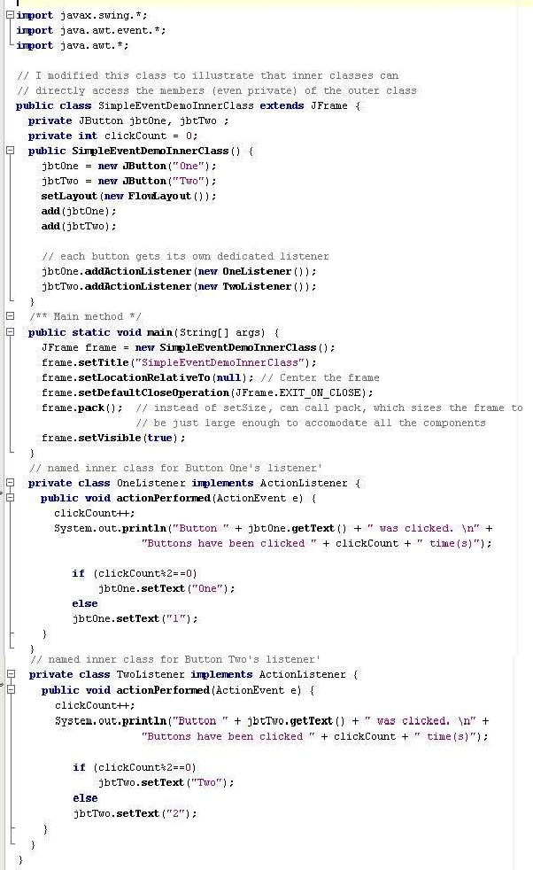
Example with named inner classes, one for listening to each button
Inner class has direct access to all members (even private) of the outer class

Slide 66
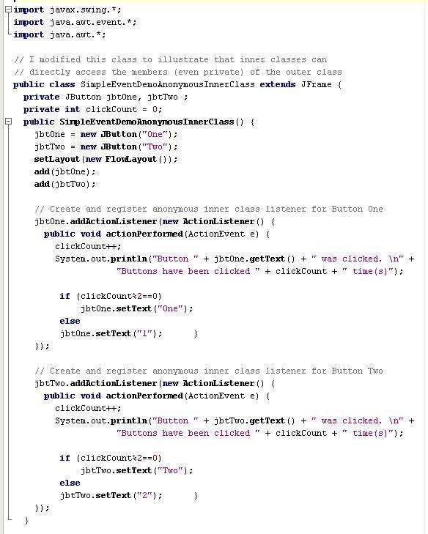
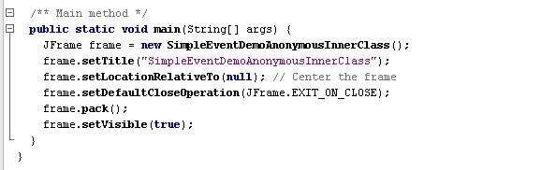
Example with anonymous inner classes, one for listening to each button

Slide 67



Thanks

